Slide 1
Program Overview
Erika Villa-Solorio
Personalized Learning Coordinator
January 25, 2018

Slide 2
The TLN is a community of learners ready to engage the instructional shifts needed to facilitate 21st century instruction and share their learnings with others.

Slide 3
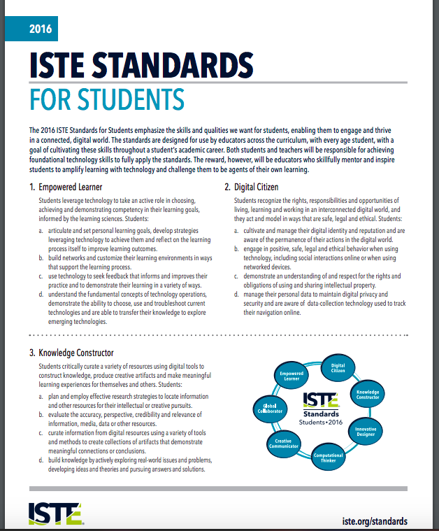
Guiding Documents

Slide 4
TLN Model
Teacher Leaders participate in a series of learning sessions to reflect upon and refine their practices in order to accomplish their self-selected goals.
Each session provides participants an opportunity to engage as learners exploring instructional practices that will empower them to provide personalized learning experiences as well as share their learnings with others.
Intensive Onboarding
Application
Semester-long Learning Sessions

Slide 5
Objectives for the TLN Model
Learn, immerse, and apply the Task Force Recommendations
Foster a Growth Mindset
Reflect on your instructional practices
Develop vision statement and plan for how to leverage digital tools and resources to support 21st century learning
Share your learnings with others

Slide 6
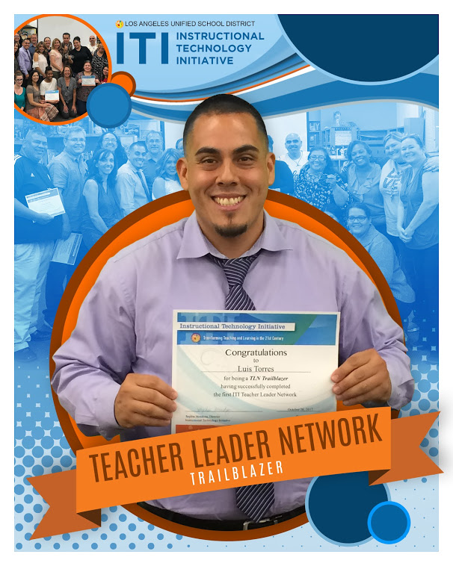
Luis Torres
TLN Graduate

Slide 7
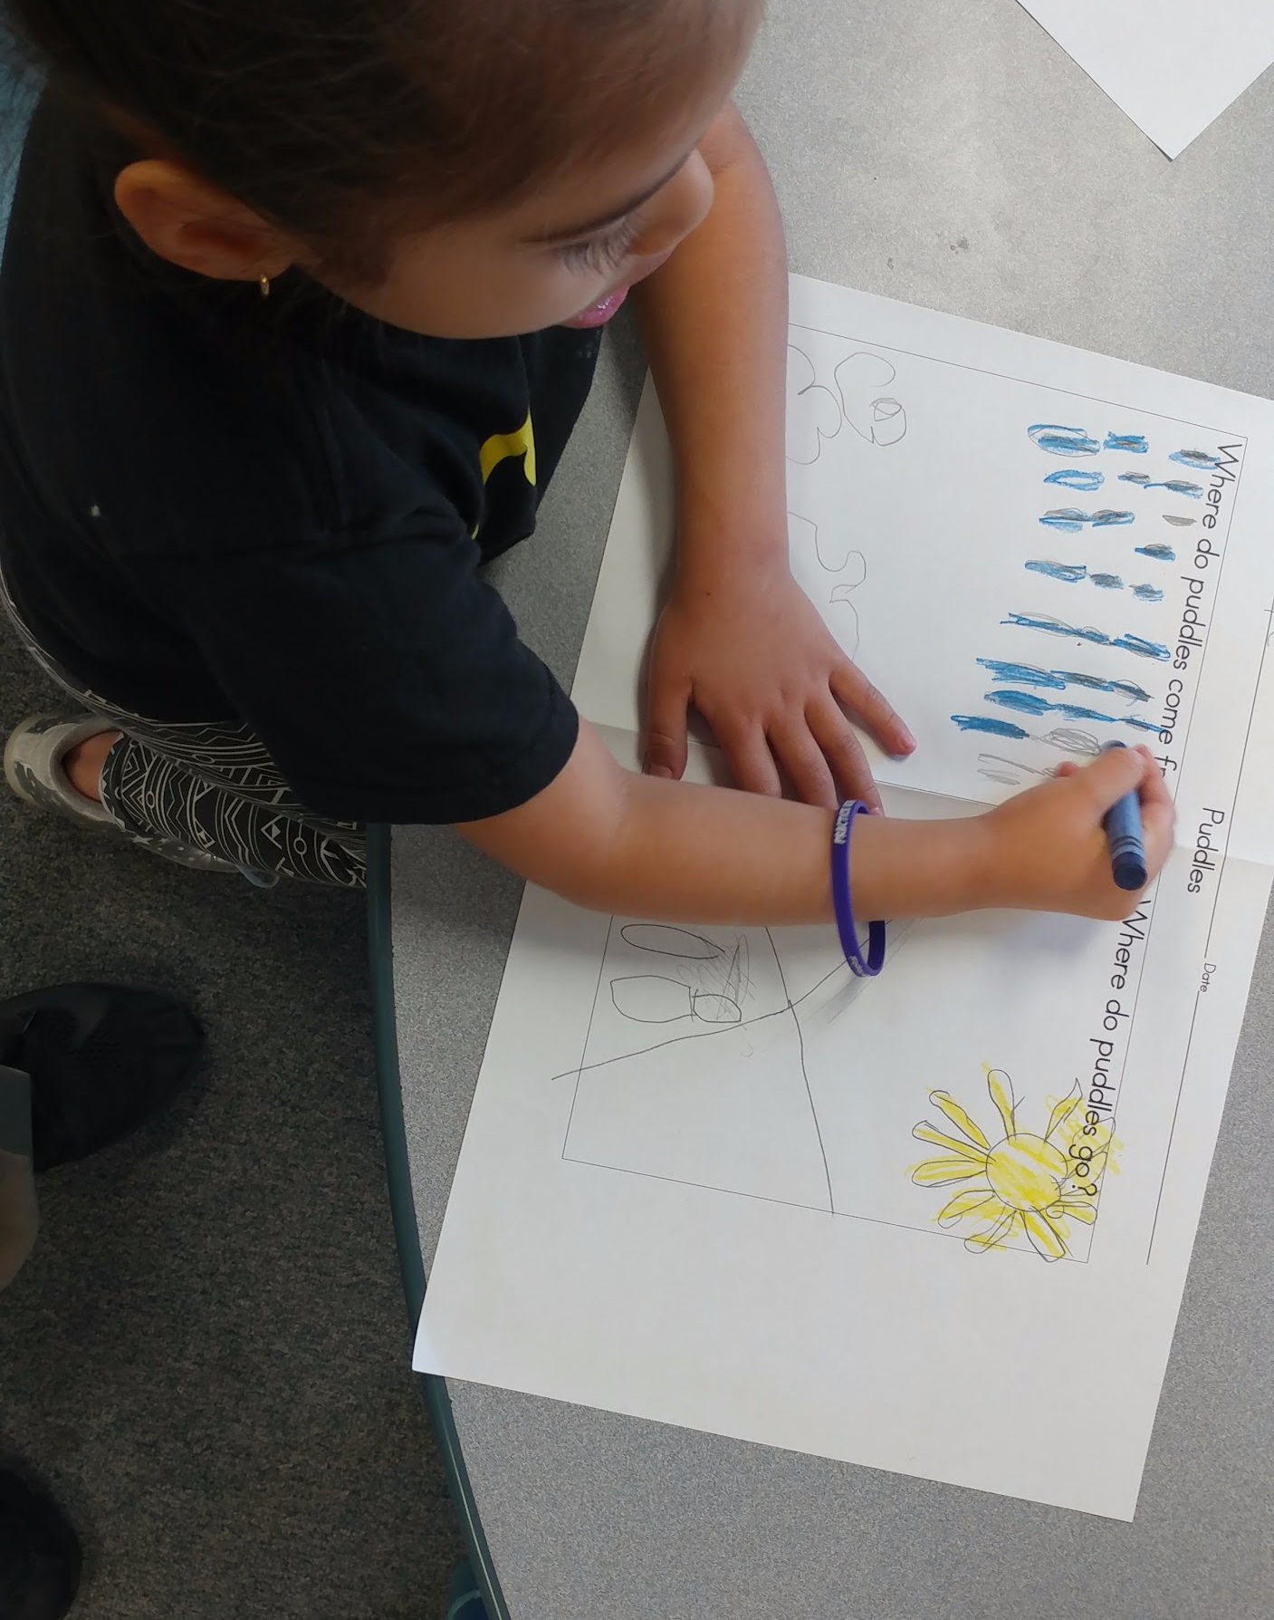
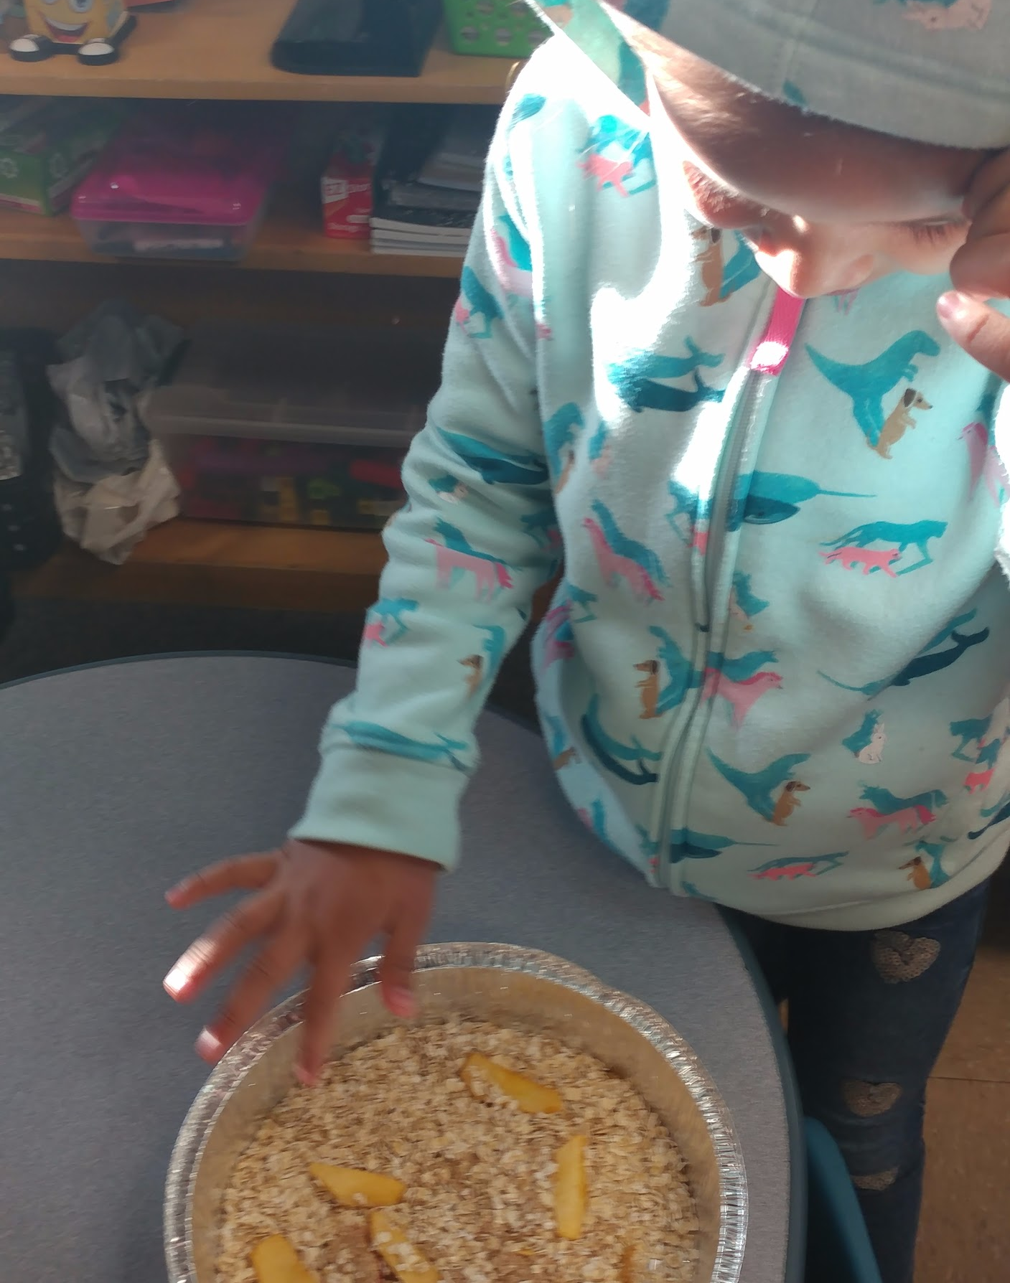
Students are learning to investigate and research. They build their learning into communication tools such as Google slides.

Slide 8
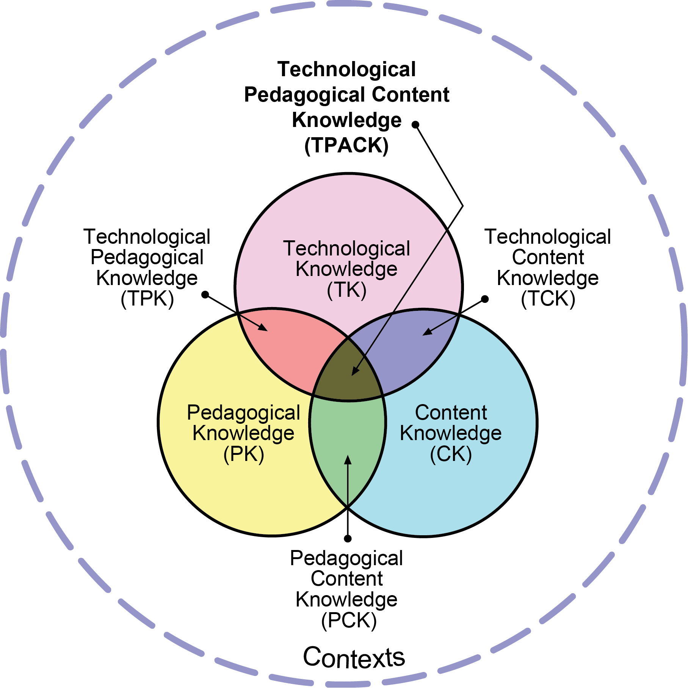
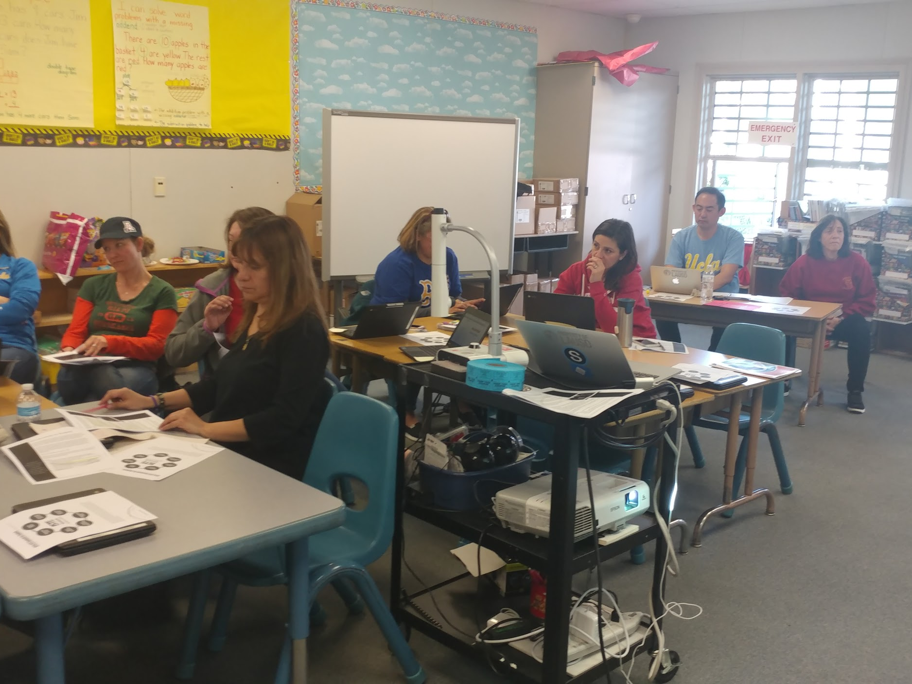
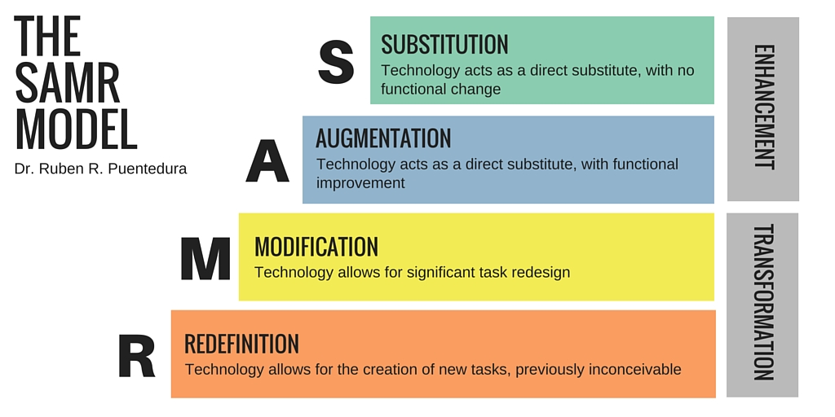
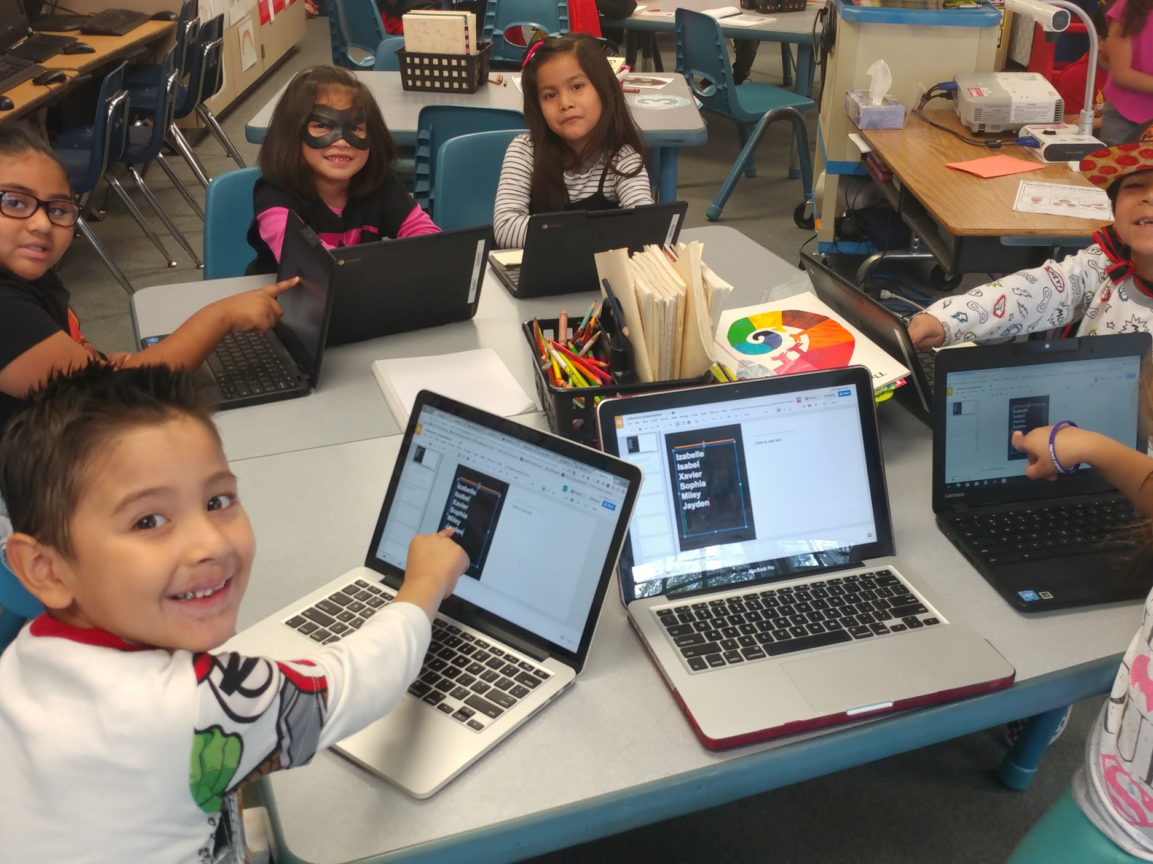
https://docs.google.com/presentation/d/1zC9pVvFSqgJvBeJ74qM3Ne41bku3GZICw2p6tjeKDxU/edit?usp=sharing
https://docs.google.com/presentation/d/1D0SgGV3KRyV1kYxDM-uxhyYICRFdQxWKY3iXxVd8NaM/edit?usp=sharing

Slide 10
Thank You
Contact
Erika Villa-Solorio
Personalized Learning Coordinator
erika.solorio@lausd.net

